Slide 1



eat it!
Recommendation-based
Grocery Shopping Service
TEAM #2 노미래 김영중 문호 이재봉 장천하 장호

Slide 2
Contents
1
Background
2
System Objectives
3
Related Services
4
Technical Background
5
Development
6
Expectancy Effects

Slide 3
Background
1
Background
2
System Objectives
3
Related Services
4
Technical Background
5
Development
6
Expectancy Effects

Slide 4



1
Background
Offline Store
Grocery Shopping
Online Store

Slide 5
1
Background
Online Grocery Shopping
Market Growth
국내 음/식료품 연간 온라인 거래액
* 단위 : 조원 * 자료 : 국가 통계 포털
국내 농축수산물 연간 온라인 거래액
* 단위 : 천억원 * 자료 : 국가 통계 포털

Slide 6
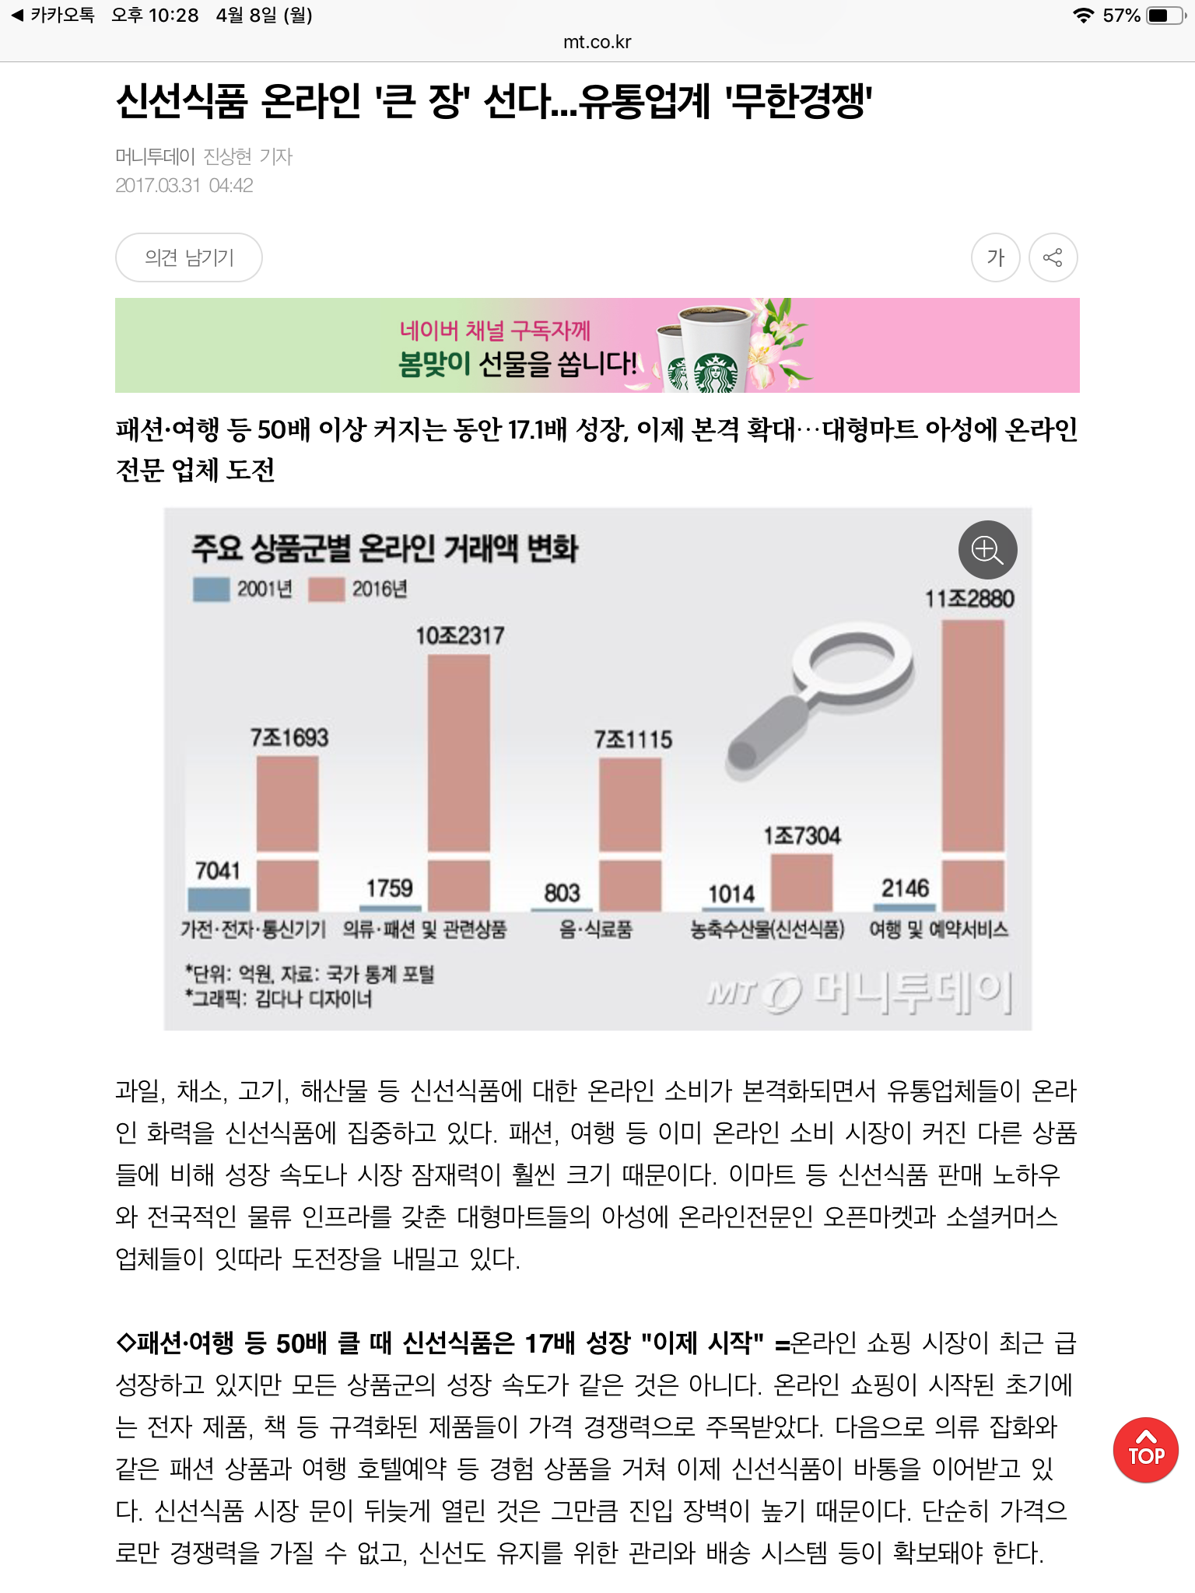
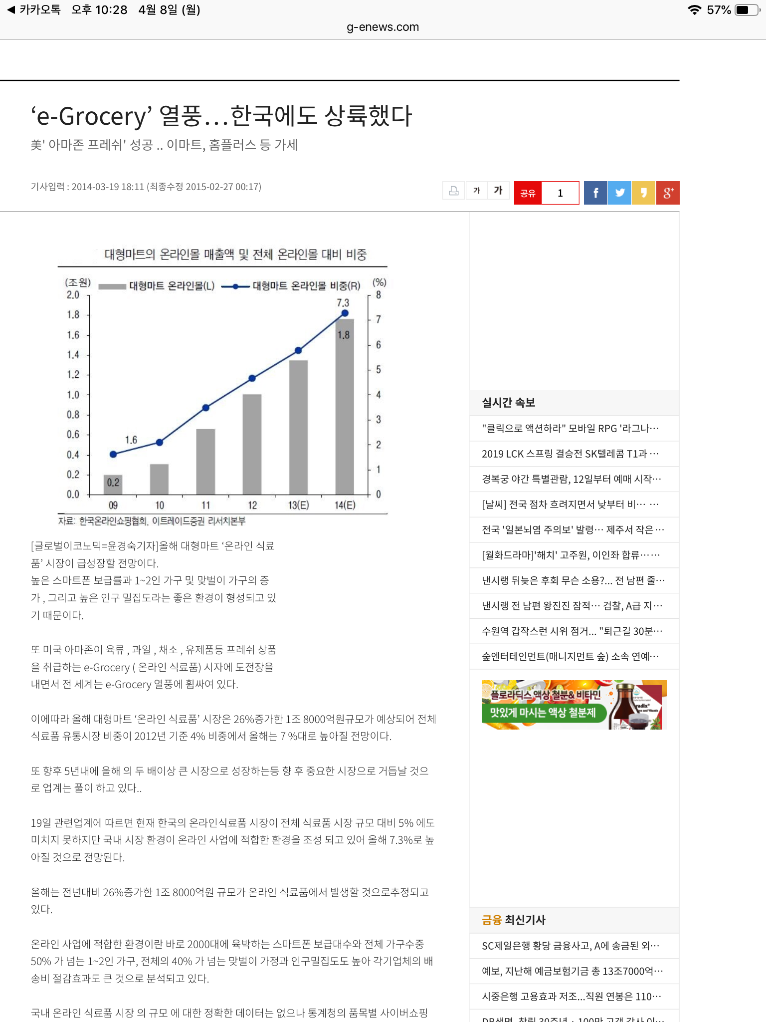
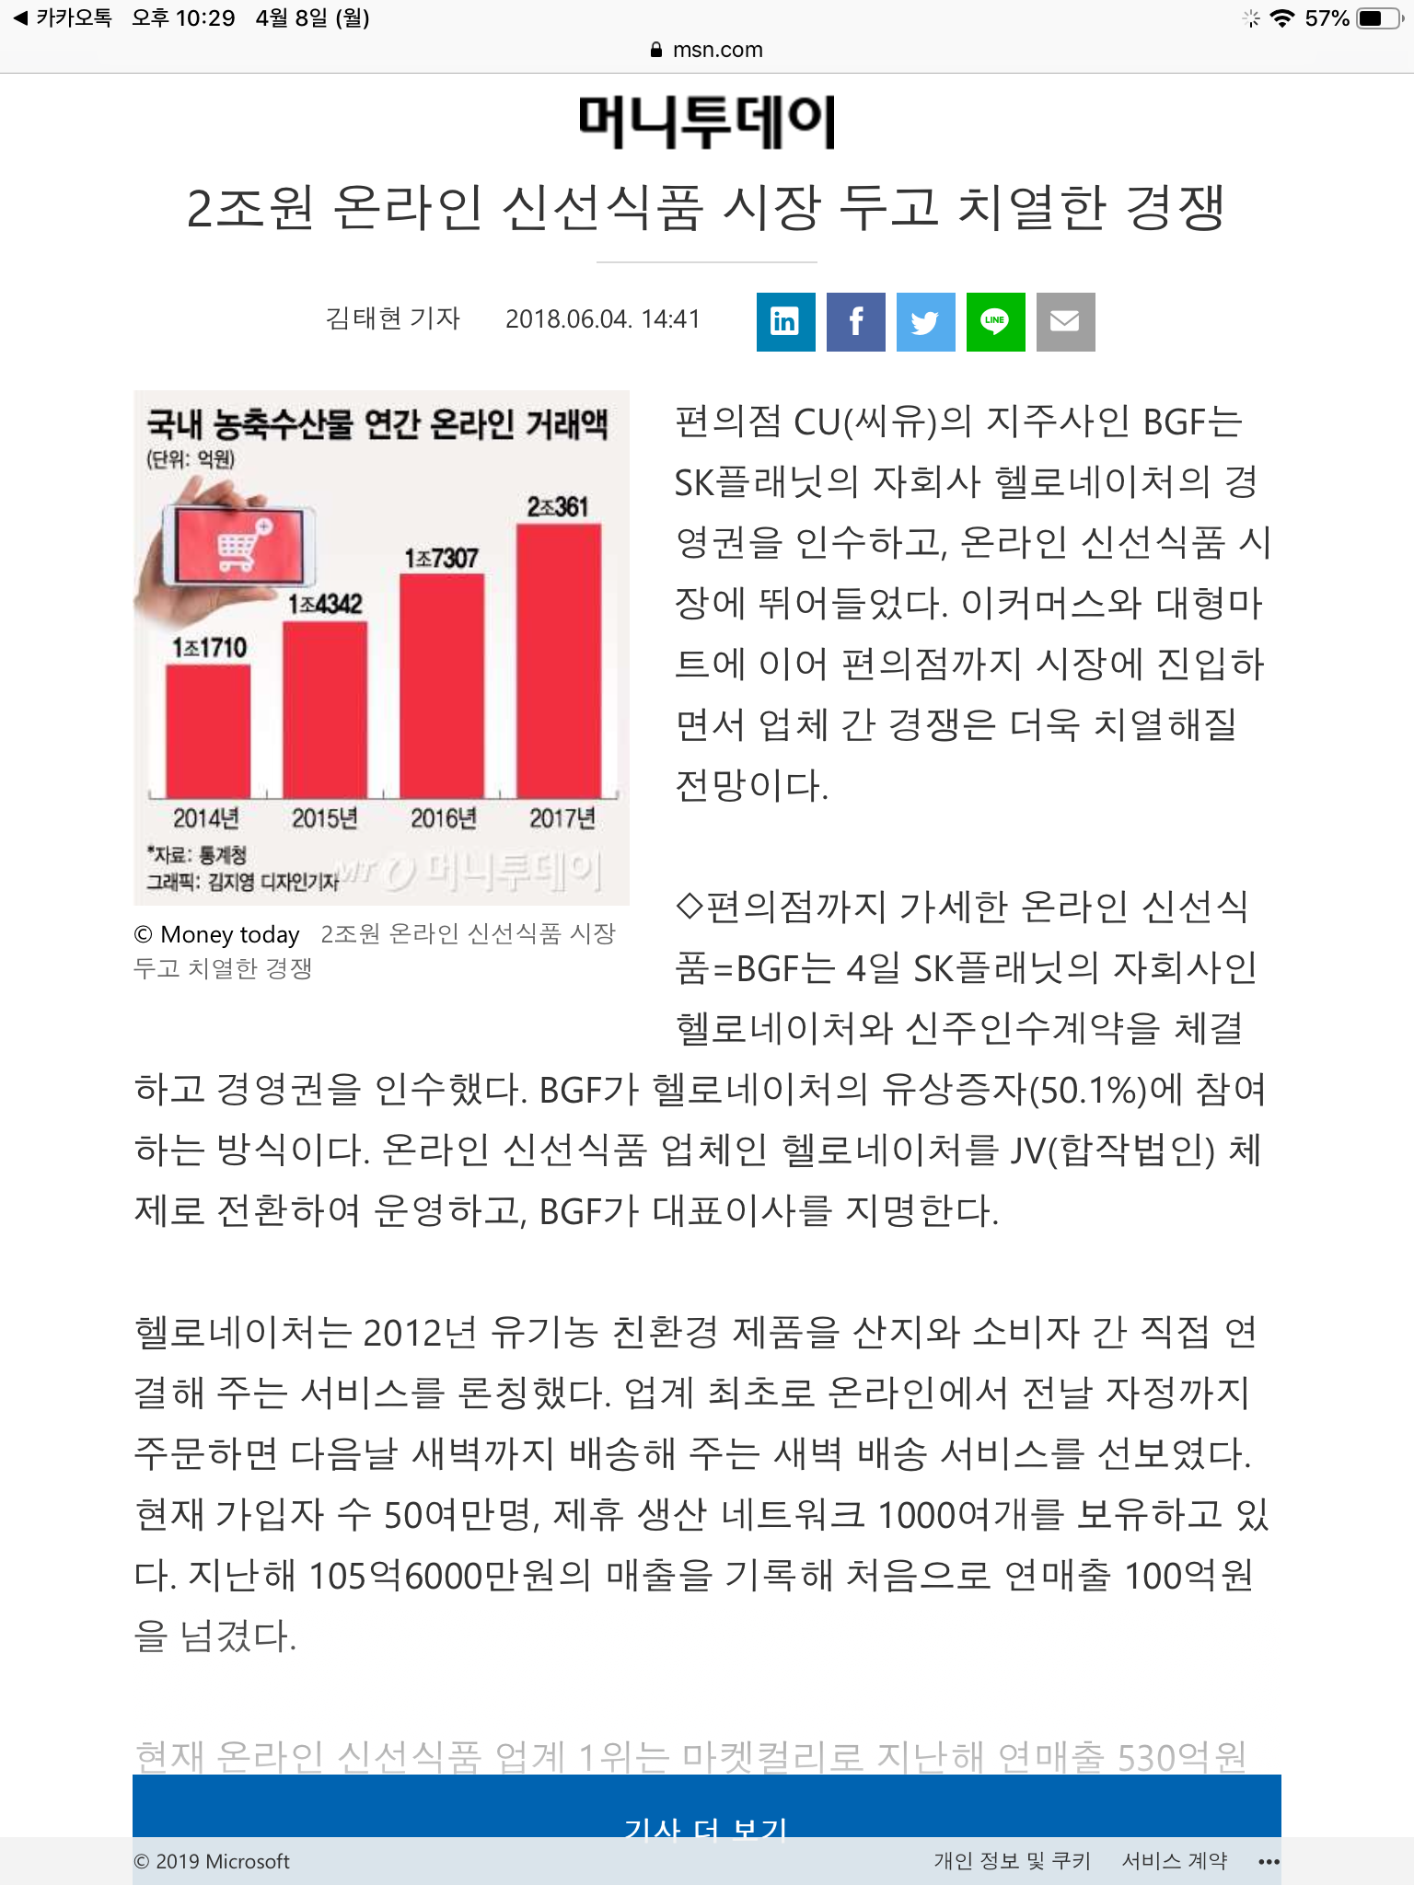
1
Background
Online Grocery Shopping
Market Growth

Slide 7
1
Background
Our Survey
Have you ever bought groceries online?
* Participants : 103
Online Grocery Shopping
Market Growth
Most of people
have been brought groceries online!

Slide 8
1
Background
Our Survey
Have you ever been bothered
because you have to pick up each item and buy it?
* Participants : 103
Online Grocery Shopping
Complaints
The user have to pick every single item

Slide 9
1
Background
Our Survey
Have you ever wondered
what to cook or what ingredients to use?
* Participants : 103
Online Grocery Shopping
Complaints
The user don’t know what to eat
and what ingredients to use!

Slide 10


1
Background
Our Suggestion
Online Grocery Shopping
Machine Learning
Recommendation-based
Grocery Shopping Service

Slide 11
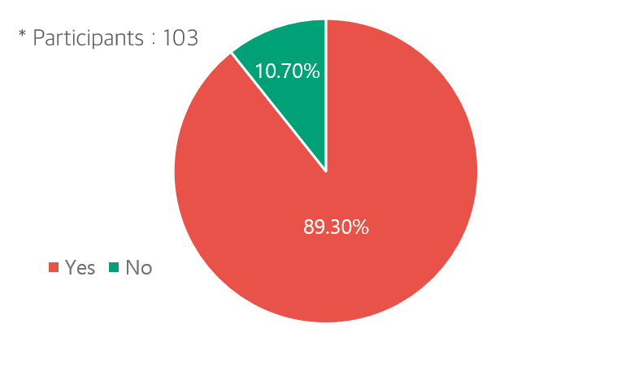

1
Background
Our Suggestion
Our Survey
Would you like to use a grocery shopping service
that recommends you what to eat for you?
Recommendation-based
Grocery Shopping Service
People would like to use
food recommendation shopping service!

Slide 12
1
Background
Objectives
2
System Objectives
3
Related Services
4
Technical Background
5
Development
6
Expectancy Effects

Slide 13

2
System Objectives
Personalized Recommendation
Our project’s main goal is to implement a personalized recommendation system based on Machine-Learning. A new user evaluates given data set of menus so that system analyzes the user’s taste. When the user want to receive a menu recommendation, the system will recommend menus that the user highly like to prefer. The system analyzes user’s taste again if the user evaluates the purchased product.

Slide 14

2
System Objectives
Provide exactly what users want
According to our survey, most users don’t know what to eat and how to cook. Therefore our service will provide effective filtering function and recipes appropriate for selected food. If the user doesn’t want to cook, he can simply select already cooked food. If he wants to cook with ingredients, the service provides required ingredients and a recipe of the menu.

Slide 15

2
System Objectives
Easy to approach, easy to use
People don’t want to consume a lot of time for getting foods, and that’s why they use online grocery shopping service. That is, accessibility and easy user experience are essential to our service. We firstly implement our service in Android environment for accessibility. Also, we’re going to analyze similar grocery shopping services and apply their convenient functions to our application for improving user experience.

Slide 16
1
Background
2
System Objectives
Related Services
3
Related Services
4
Technical Background
5
Development
6
Expectancy Effects

Slide 17

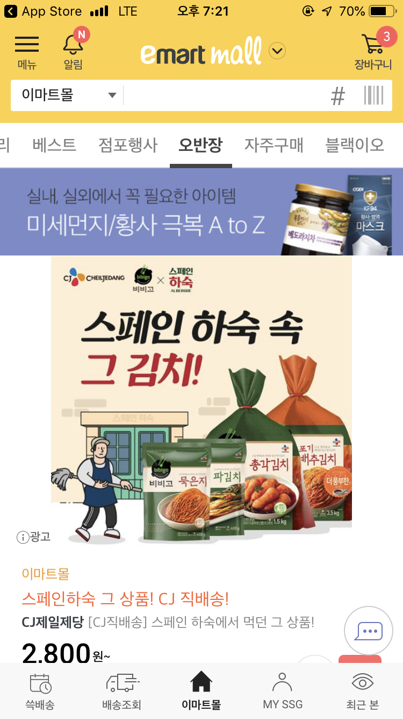
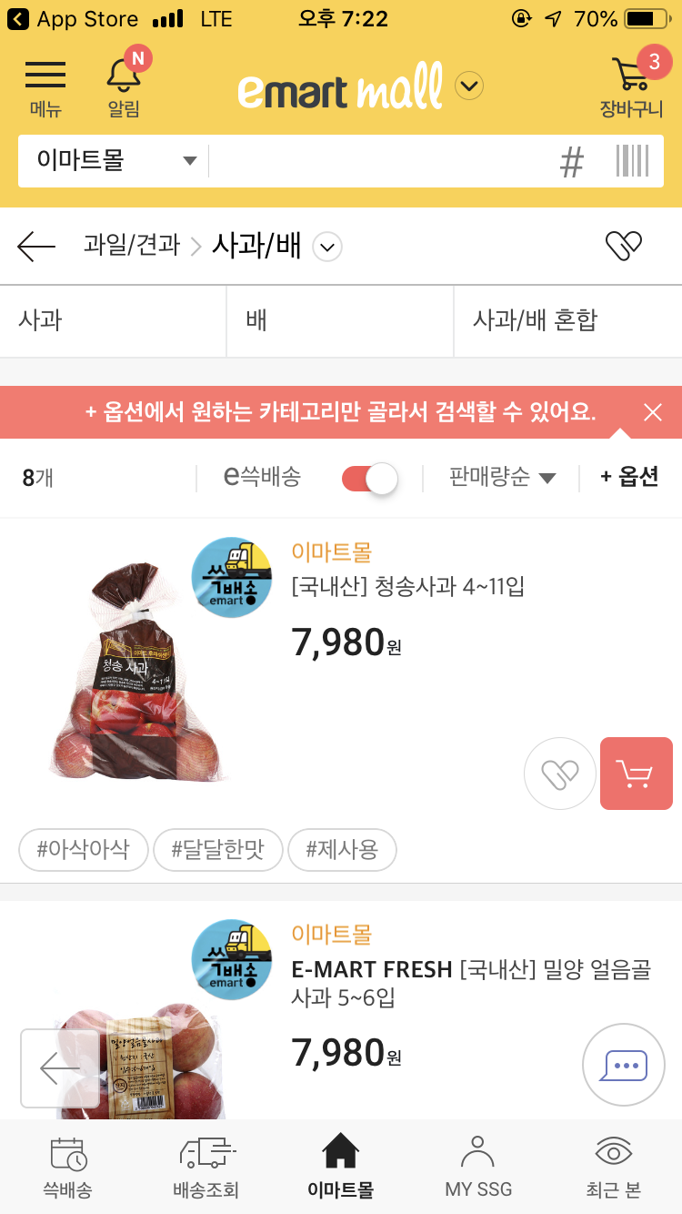
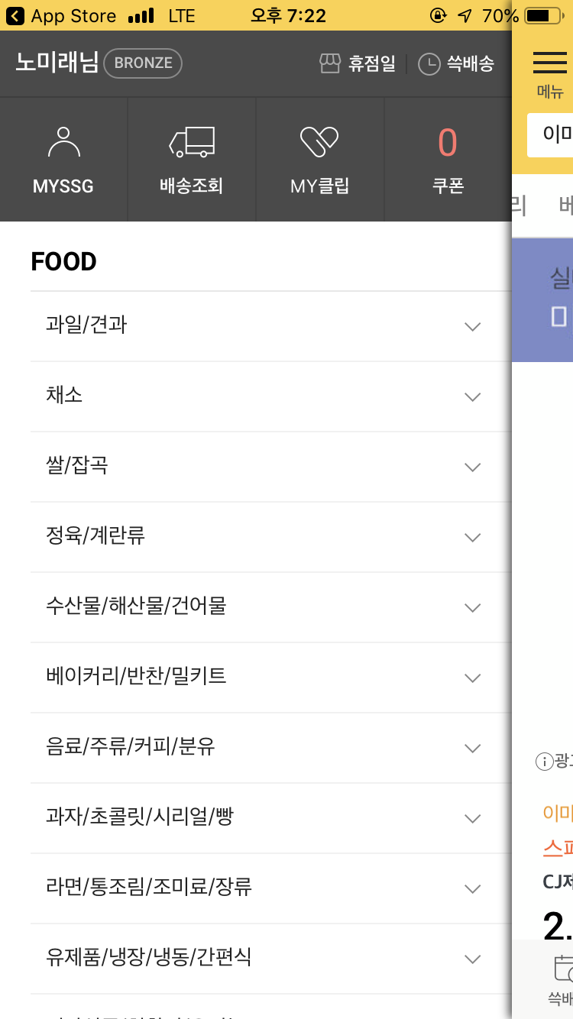

3
Related Services
Emart Mall
Checklist
Personal Recommendation
Provide menus’ recipes
Single ingredient shopping
Food filtering by cooking type

Slide 18
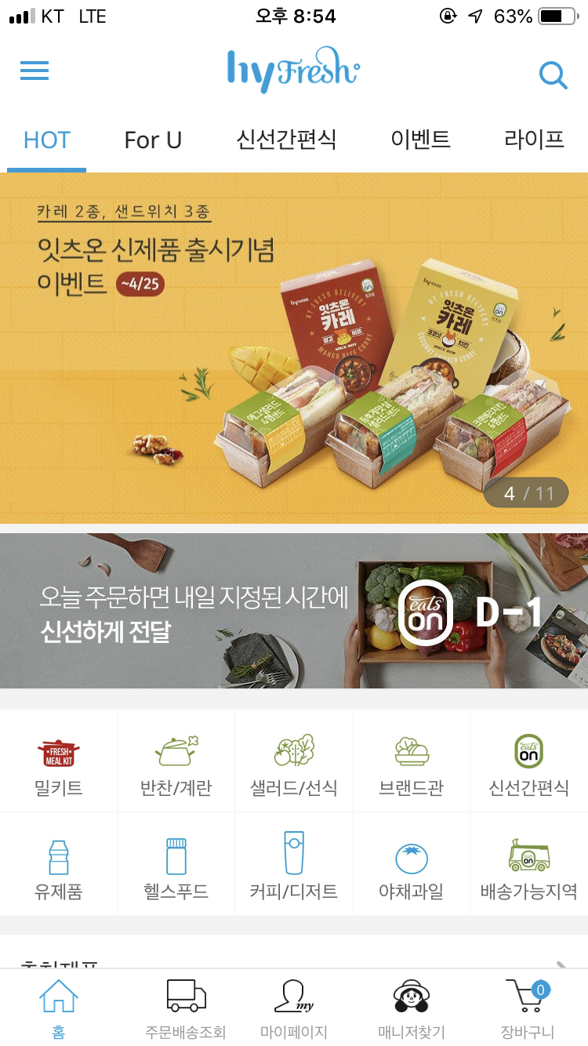
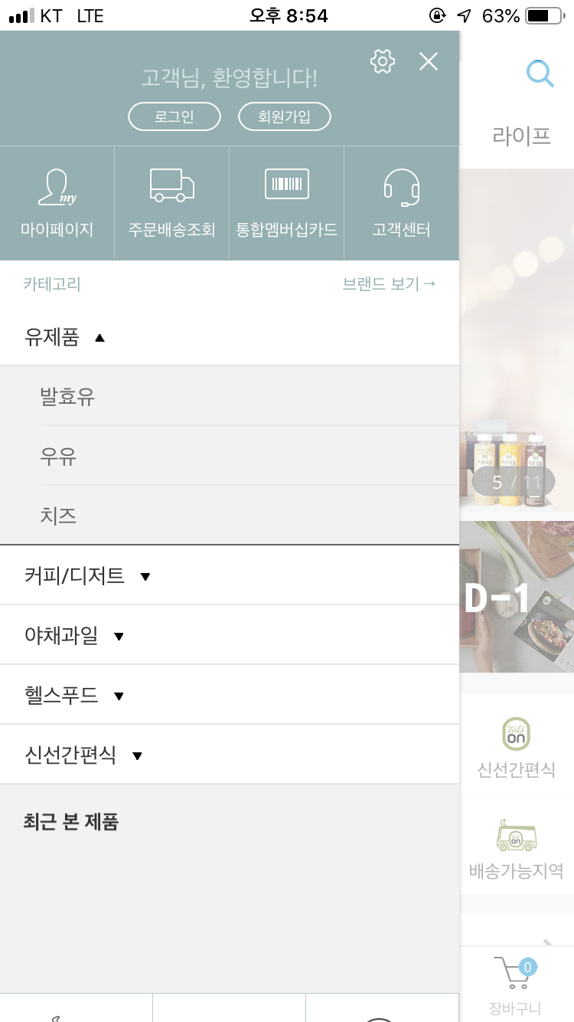
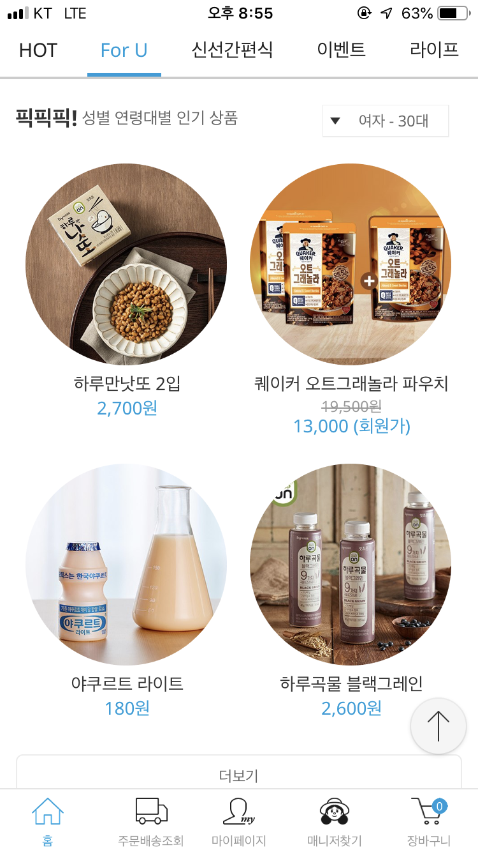
3
Related Services
Hyfresh
Checklist
Personal Recommendation
Provide menus’ recipes
Single ingredient shopping
Food filtering by cooking type

Slide 19
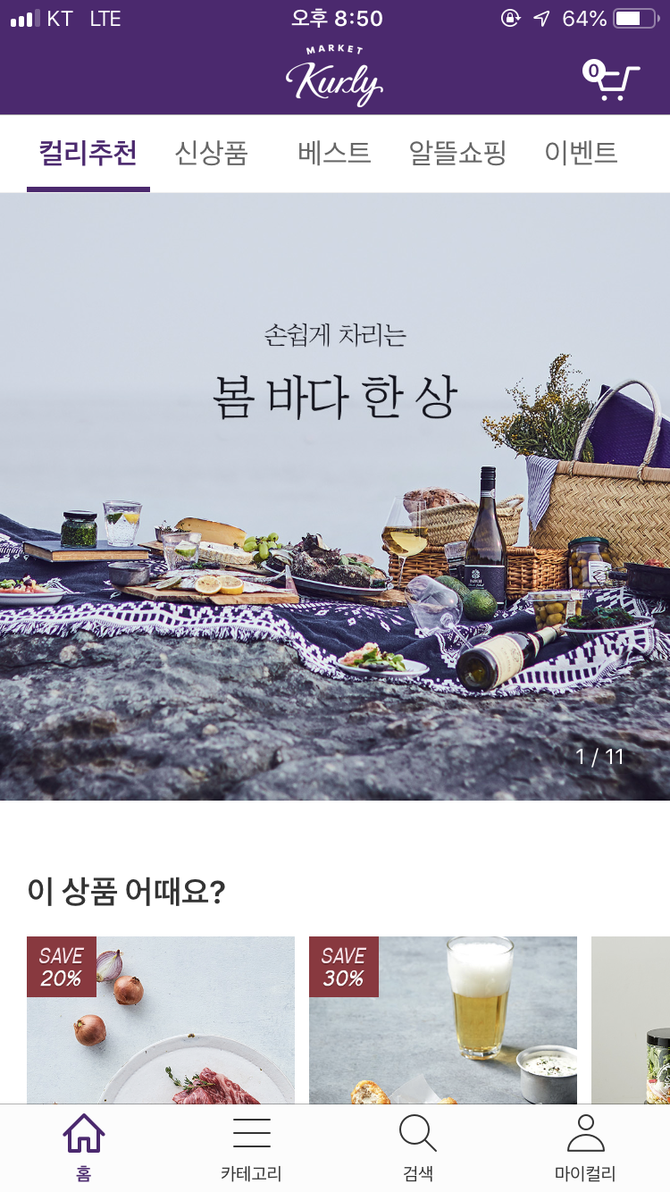
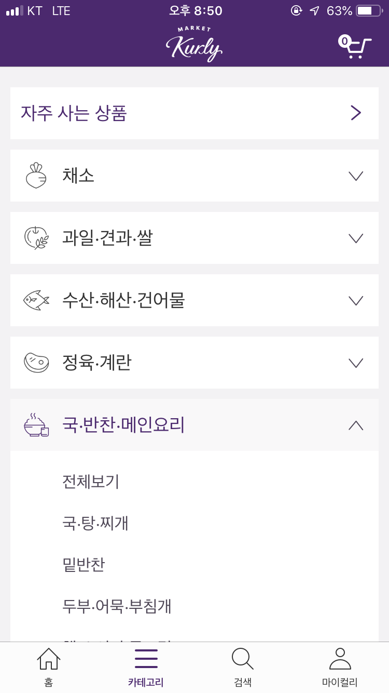
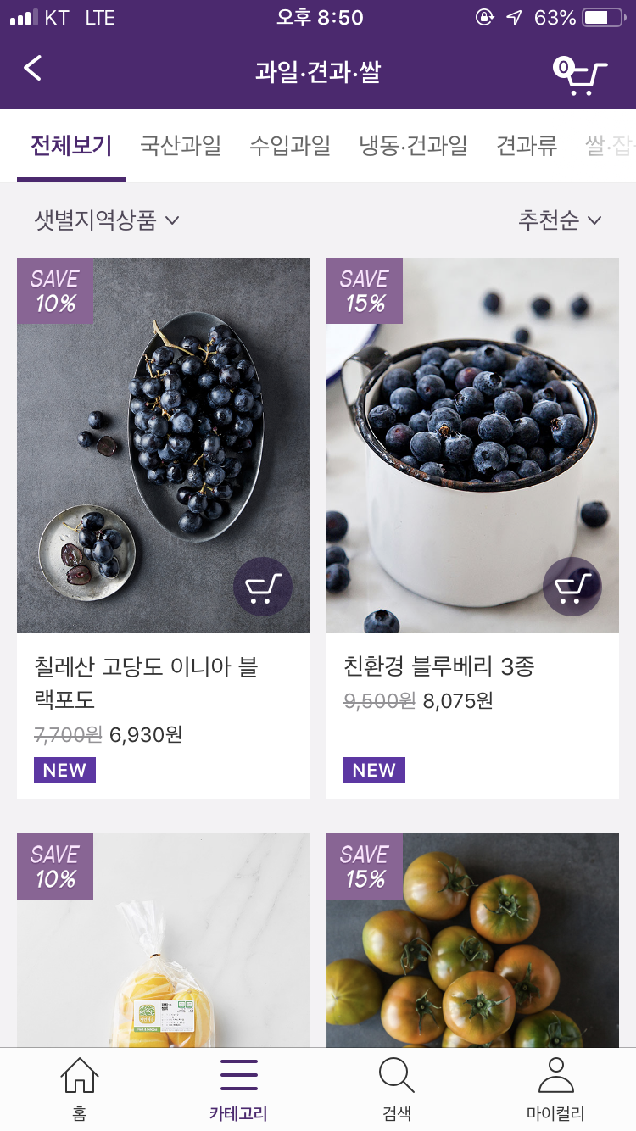
3
Related Services
Market Kurly
Checklist
Personal Recommendation
Provide menus’ recipes
Single ingredient shopping
Food filtering by cooking type

Slide 20



3
Related Services
 | Personal Recommendation | Provide Recipes | Single Ingredient Shopping | Filtering by Cooking Type
 | X | X | O | O
 | O | O | X | X
 | X | O | O | X
 | O | O | O | O

Slide 21
1
Background
2
System Objectives
3
Related Services
Technical Background
4
Technical Background
5
Development
6
Expectancy Effects

Slide 22



4
Technical Backgrounds
Front-End
Back-End
Android Studio
Front-end development
MySQL
Database for our system
Node.js
Server for our system

Slide 23




4
Technical Backgrounds
Machine Learning
APIs
TensorFlow
Machine-Learning Framework
Firebase ML Kit
For running TensorFlow in Android
Naver & Kakao
For quick register and login

Slide 24
1
Background
2
System Objectives
3
Related Services
4
Technical Background
Development
5
Development
6
Expectancy Effects

Slide 25


5
Flowchart
Register
Evaluate
Given menu set
Analyze
User’s taste
new user
User analysis
Main menu
Choose
Food type
Menu
Recommendation
Purchased munu
Evaluate
Purchased menu
Update
User’s taste
user
Notes:
서비스 메인 기능(음식 추천 시스템) 플로우차트

Slide 26




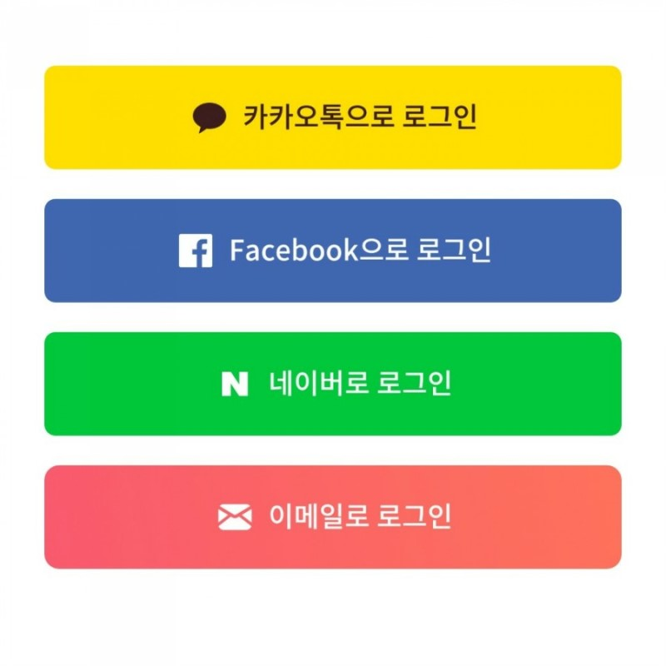
5
UI Prototype
58
취향 분석을 위해 음식을 평가해주세요.
Start Page
We provides quick login service through kakao and NAVER.
음식1
엽기 떡볶이
First Evaluation
A new user have to evaluate given menus for taste analyzing.
음식2
국물 닭발
음식3
춘천 닭갈비
음식4
카프레제 샐러드

Slide 27






5
UI Prototype
장바구니
당신이 좋아하실 만한 음식을 추천해드려요!
음식1
매콤 닭갈비
음식1
매콤 닭갈비
재료1
재료1
재료1
재료1
재료1
재료1
Main Menu
We suggests menus that the user will like. The user can see the menu and its ingredients. The user can pick item to cart.
Cart
Users can see what they picked. They can check whole price and press order button to order them.
음식1
매콤 닭갈비
음식1
제육볶음
재료1
재료1
재료1
재료1
재료1
재료1
음식1
얼큰우동
재료1
재료1
재료1
상품금액
배송비
결제예정금액
28,000원
2,500원
30,500원
음식1
순두부 찌개
재료1
재료1
재료1
주문하기
추천
검색
마이페이지

Slide 28
5
UI Prototype
치킨
취소
맛있게 드셨는지 알려주세요!
음식1
간장 치킨
음식1
매콤 닭갈비
재료1
재료1
재료1
Search
Users can see what they exactly want to buy through search tab.
Post Evaluation
After the users get and eat the food, they can evaluate purchased products. The result affects the taste analysis system.
음식1
닭 볶음탕
음식1
제육볶음
재료1
재료1
재료1
음식1
매콤 닭갈비
재료1
재료1
재료1
음식1
치킨 샐러드
재료1
재료1
재료1
추천
검색
마이페이지
추천
검색
마이페이지

Slide 29
1
Background
2
System Objectives
3
Related Services
4
Technical Background
5
Development
Expectancy Effects
6
Expectancy Effects

Slide 30

5
Expectancy Effects
Resolving Customer’s Worries
User do not have to pick every food for grocery shopping. Our service provides every recommendation. They just have to pick!
Personalized Solution
Taste analyzing done by machine learning system provides not universal recommendation, but personalized recommendation.
Notes:
서비스 메인 기능(음식 추천 시스템) 플로우차트

Slide 31
5
Expectancy Effects
Convenience
Users do not have to go through bothering processes to get food. The service provides easily accessible environment and convenient user experiences.
One Service Providing Everything
Users do not have to search recipes and ingredients for preparing single meal. The service provides all ingredients and the recipe when the user pick suggested menu.
Notes:
서비스 메인 기능(음식 추천 시스템) 플로우차트

Slide 32
Thank you!
References
http://news.mt.co.kr/mtview.php?no=2017032916371295720
https://www.mysql.com/
http://www.g-enews.com/view.php?ud=201403191811420092386_1
https://firebase.google.com/?hl=ko
https://firebase.google.com/docs/ml-kit/?hl=ko
https://nodejs.org/ko/
https://medium.com/over-engineering/building-a-custom-machine-learning-model-on-android-with-tensorflow-lite-26447e53abf2
https://www.tensorflow.org/
https://www.flaticon.com/free-icon/apple_135728
https://www.flaticon.com/free-icon/salad_135715
https://www.flaticon.com/free-icon/cheese_135652
https://www.flaticon.com/free-icon/shop_1652684
https://www.flaticon.com/free-icon/online-shop_321796
https://www.flaticon.com/free-icon/brain_897167
https://www.flaticon.com/free-icon/good_1027618
https://www.flaticon.com/free-icon/user_149071
https://www.flaticon.com/free-icon/in-love_136362
https://www.flaticon.com/free-icon/winking_136216
https://www.flaticon.com/free-icon/sad_136326
https://www.flaticon.com/free-icon/shopping-cart_60992
https://www.flaticon.com/free-icon/menu-button_60510
https://www.flaticon.com/free-icon/close-button_61155
https://www.flaticon.com/free-icon/customer_686379
https://www.flaticon.com/free-icon/groceries_135763

